Slide 1

Apex Institute of Technology
Department of Computer Science & Engineering
Data Mining and Warehousing
(CSF-334)
Dr Neha Agarwal
E11231
Assistant Professor
CSE(AIT), CU
DISCOVER . LEARN . EMPOWER

Slide 2
Contents to be Covered
Why Data Preprocessing
Importance
Forms of Data Preprocesssing

Slide 3
Why Data Preprocessing?
Data in the real world is dirty
incomplete: lacking attribute values, lacking certain attributes of interest, or containing only aggregate data
e.g., occupation=“”
noisy: containing errors or outliers
e.g., Salary=“-10”
inconsistent: containing discrepancies in codes or names
e.g., Age=“42” Birthday=“03/07/1997”
e.g., Was rating “1,2,3”, now rating “A, B, C”
e.g., discrepancy between duplicate records

Slide 4
Why Is Data Dirty?
Incomplete data comes from
n/a data value when collected
different consideration between the time when the data was collected and when it is analyzed.
human/hardware/software problems
Noisy data comes from the process of data
collection
entry
transmission
Inconsistent data comes from
Different data sources
Functional dependency violation

Slide 5
Why Is Data Preprocessing Important?
No quality data, no quality mining results!
Quality decisions must be based on quality data
e.g., duplicate or missing data may cause incorrect or even misleading statistics.
Data warehouse needs consistent integration of quality data
Data extraction, cleaning, and transformation comprises the majority of the work of building a data warehouse. —Bill Inmon

Slide 6
Multi-Dimensional Measure of Data Quality
A well-accepted multidimensional view:
Accuracy
Completeness
Consistency
Timeliness
Believability
Value added
Interpretability
Accessibility
Broad categories:
intrinsic, contextual, representational, and accessibility.

Slide 7
Major Tasks in Data Preprocessing
Data cleaning
Fill in missing values, smooth noisy data, identify or remove outliers, and resolve inconsistencies
Data integration
Integration of multiple databases, data cubes, or files
Data transformation
Normalization and aggregation
Data reduction
Obtains reduced representation in volume but produces the same or similar analytical results
Data discretization
Part of data reduction but with particular importance, especially for numerical data

Slide 8
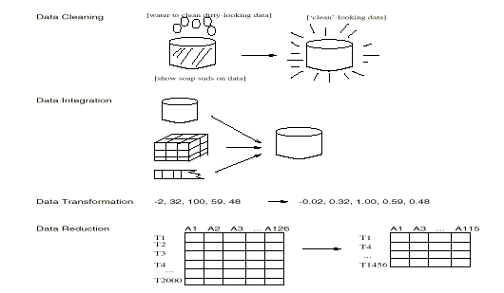
Forms of data preprocessing

Slide 9
Homework
Discuss the concept of Data Preprocessing
What are the forms of Data Preprocessing

Slide 10
References
TEXT BOOKS
Introduction to Data Mining, Tan, Steinbach and Vipin Kumar, Pearson Education, 2016
REFERENCE BOOKS
Data Mining: Concepts and Techniques, Pei, Han and Kamber, Elsevier
Journals:
http://www.ijsmsjournal.org/ijsms-v4i4p137.html
https://www.springer.com/journal/41060

Slide 11
Thank you
Please Send Your Queries on:
e-Mail: neha.e11231@cumail.in

